Slide 1

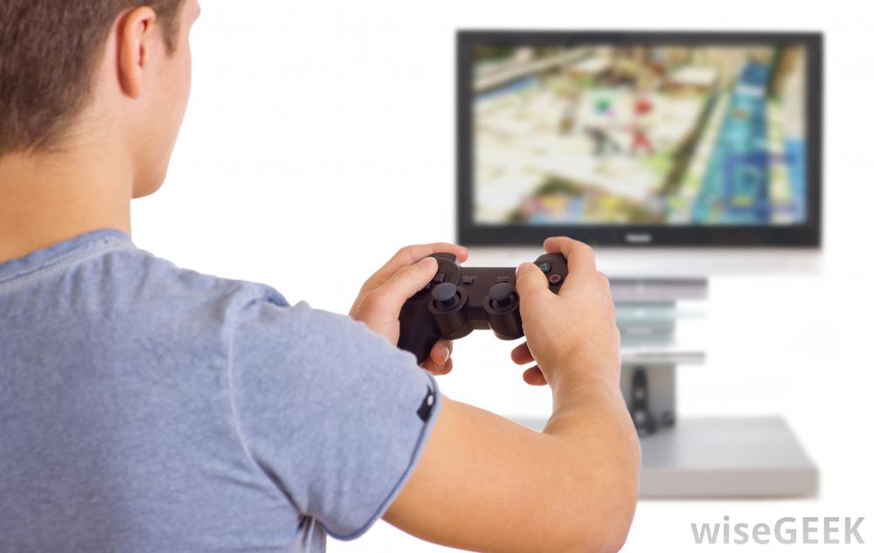
1. Games Background
Let’s Learn
Aj. Andrew Davison, CoE, PSU Hat Yai Campus
E-mail: ad@fivedots.coe.psu.ac.th

Slide 2
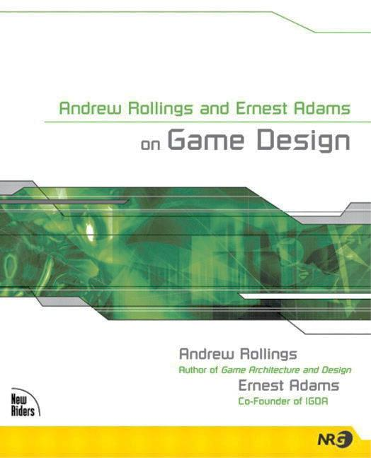
1. What is a Game?
A game is a form of interactive entertainment where players must overcome challenges, by taking actions that are governed by rules, in order to meet a victory condition.
Rollings & Adams

Slide 3
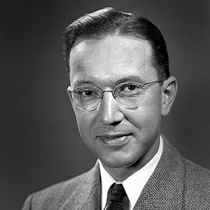
2. First "Computer" Games
William Higginbotham and Tennis for Two
created in 1958 for Brookhaven National Laboratory’s visitor day
display was an oscilloscope
sound effects were hardware noises

Slide 4
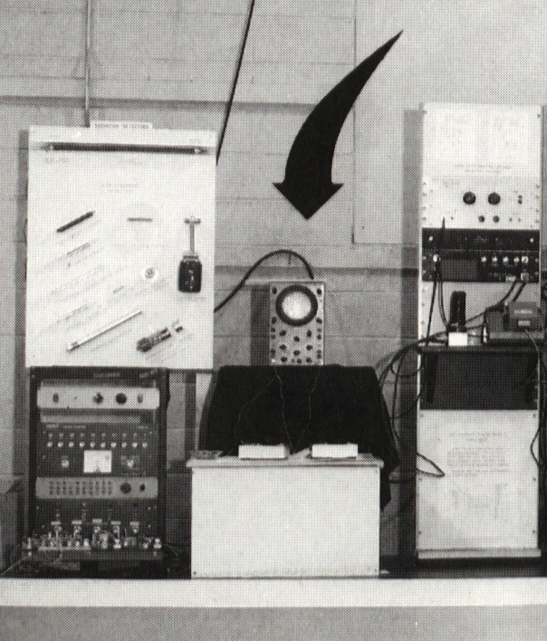
The oscilloscope is in the middle with two controllers
The Donner analog computer is on the left.

Slide 5
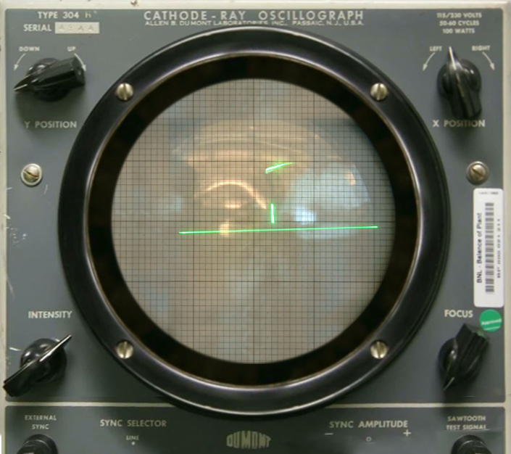

Slide 6

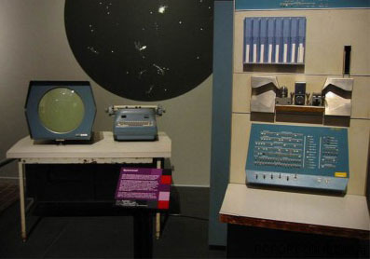
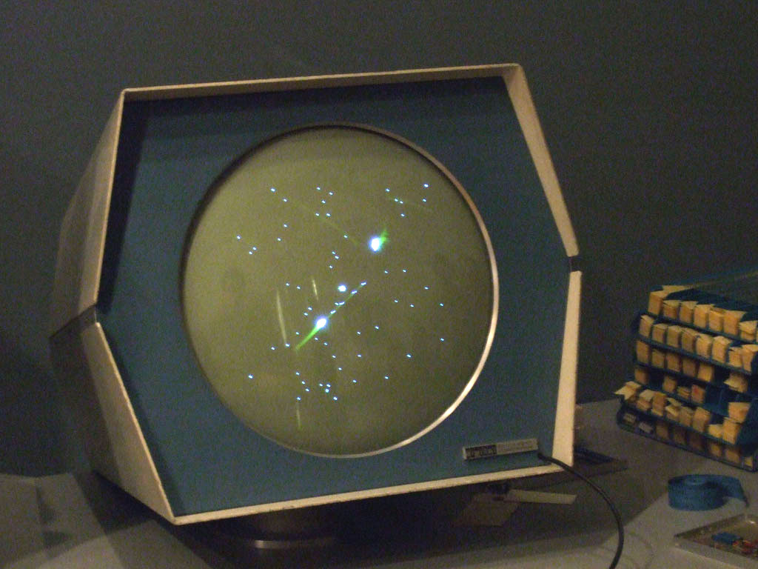
Steve Russell and Spacewar!
Created in 1961 at MIT for the DEC PDP-1 computer
very popular

Slide 7
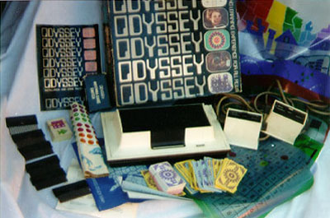
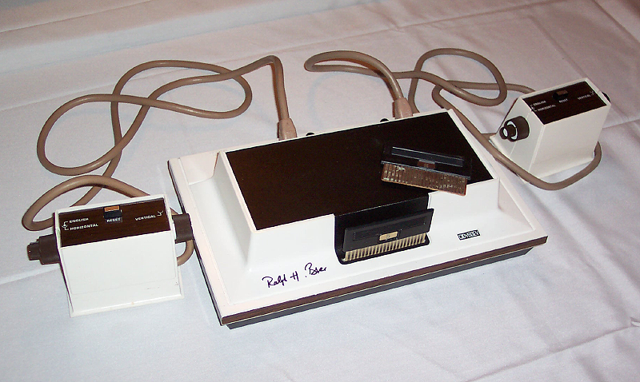
1972 Ralph Baer, Magnavox Odyssey
Several games: tennis, hockey, etc.

Slide 8
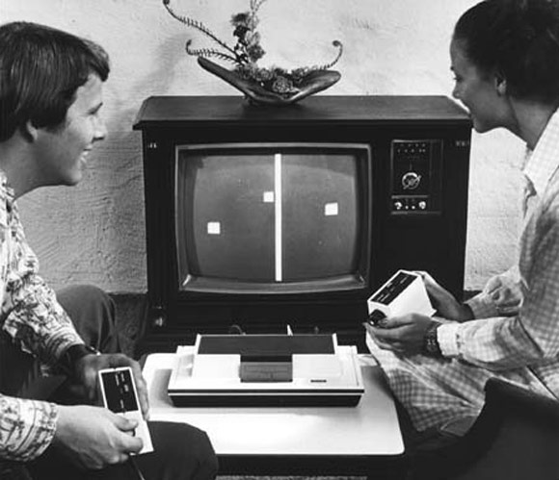
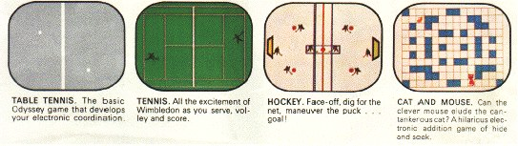

Slide 9
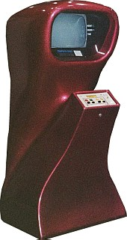

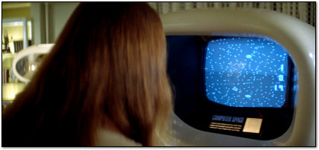
1973: "Computer Space"
based on Spacewar!
first commercial electronic arcade game
too unusual, failed

Slide 10
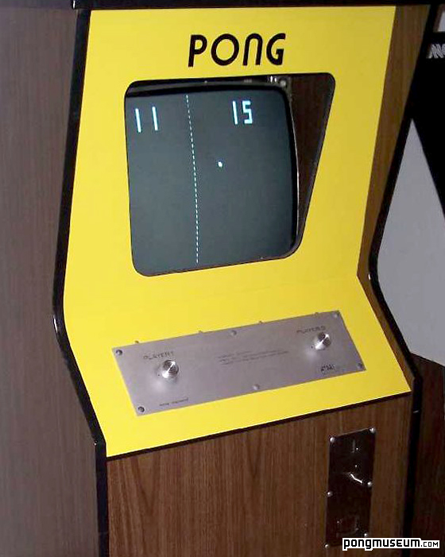
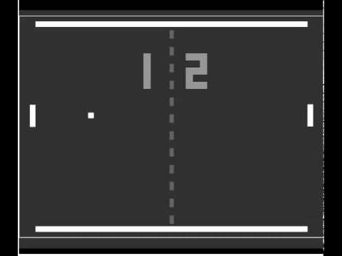
1974: Pong
big hit in arcades

Slide 11
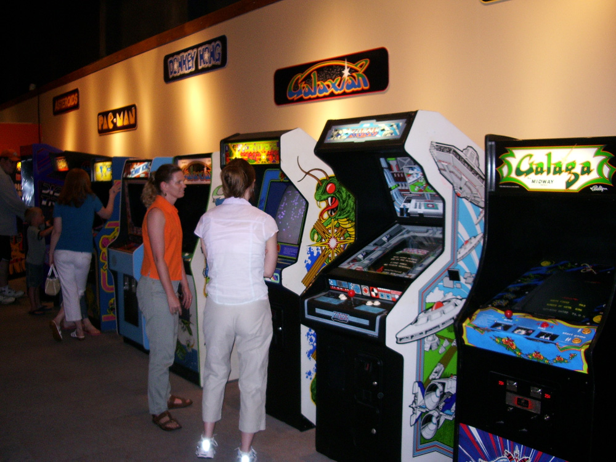
What's an Arcade?
An arcade was a shop full of computer game machines
each machine could play only one game

Slide 12
3. Game Types
Arcade Games
Pong, Breakout, Pacman
Fixed 2D Shooters
Space Invaders
Platformers
side-scrollers
Puzzle Games
Tetris
Traditional Games
Chess, Go, Solitaire
First Person Shooters (FPSs)
Role Playing Games (RPGs)
Massive Multiplayer Online Games (MMOGs)
Sports Games
Party Games
Simulators
Real-time Strategy (RTSs)
Educational/Serious Games

Slide 13
Arcade Games
Test your speed
Pong, Breakout, Pacman
Good starting point for writing your first game
Pong

Slide 14
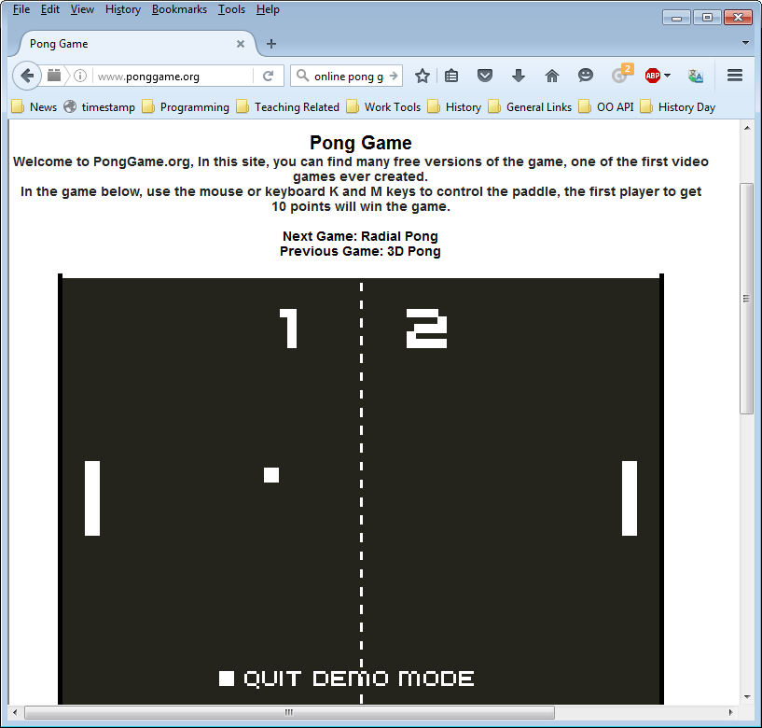
Version online at http://www.ponggame.org/

Slide 15
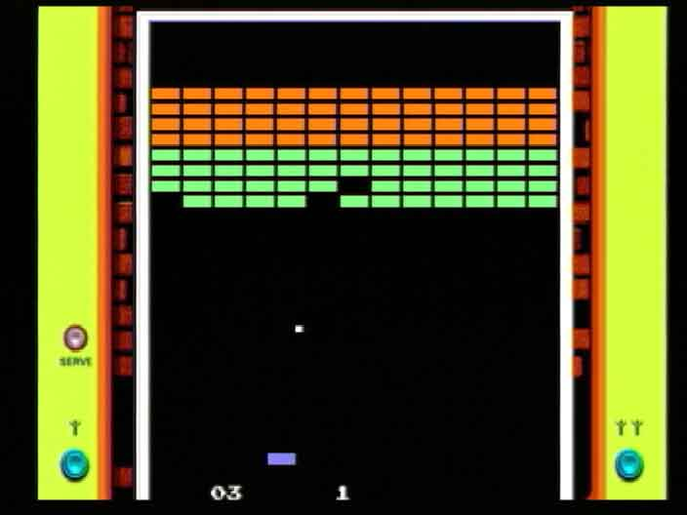
Breakout

Slide 16
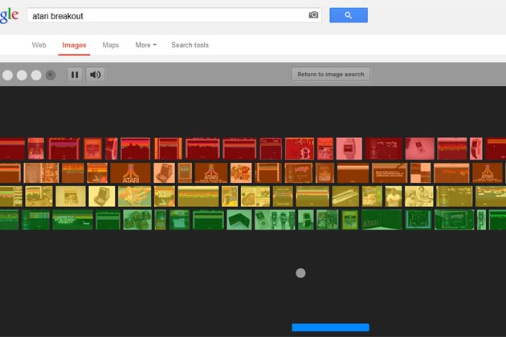
Type "atari breakout" into Google to play it.

Slide 17
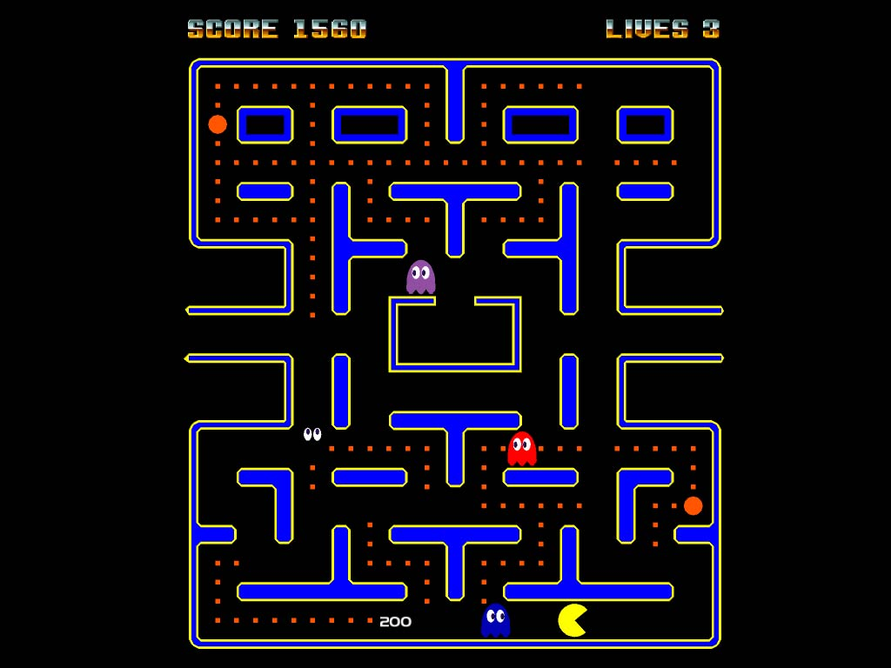
Pacman

Slide 18
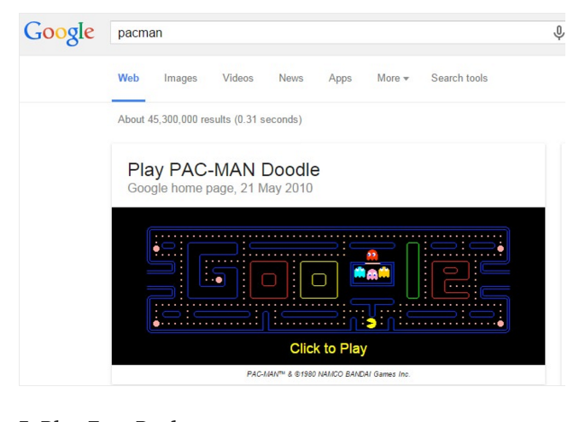
Type "pacman" into Google to play it.

Slide 19
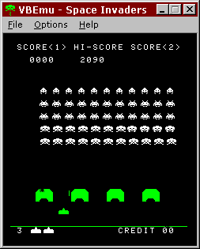
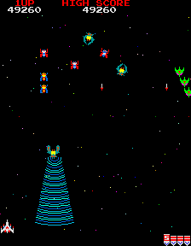
Fixed 2D Shooters
Space Invaders, Galaga, R-Type, etc.

Slide 20
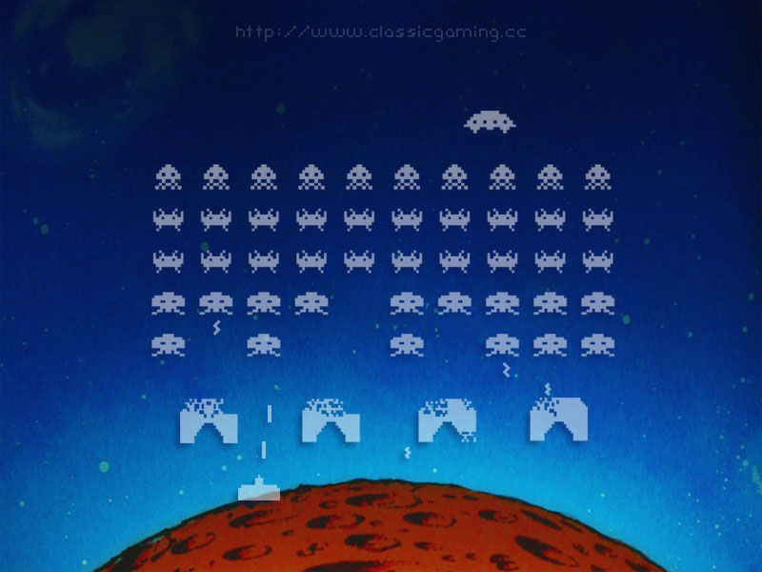
Space Invaders

Slide 21
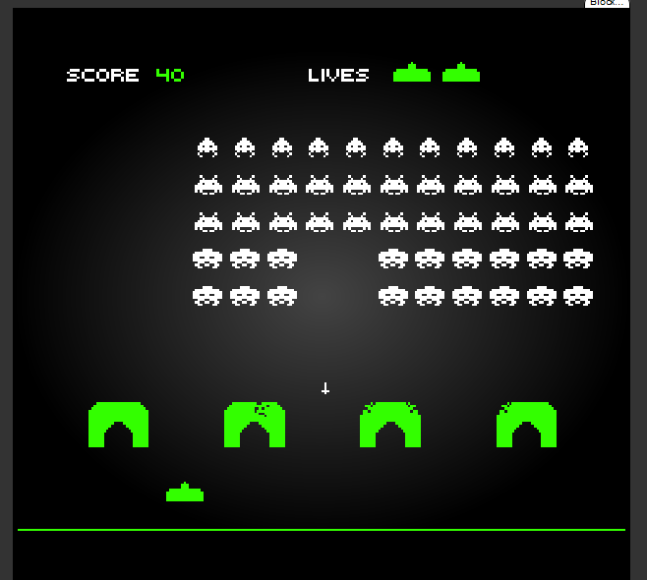
Online Space Invaders: http://www.pacxon4u.com/space-invaders/

Slide 22
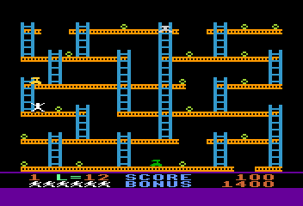
Platformer
Running, jumping
‘Side-scrollers’ – usually seen from side
e.g. Mario Brothers, Donkey Kong, Sonic

Slide 23
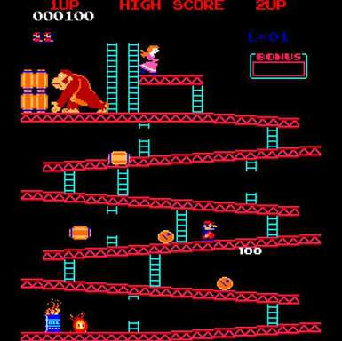
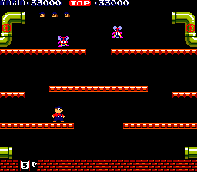
Mario Bros
Donkey Kong

Slide 24
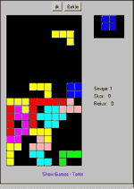
Puzzle Games
Solve puzzle or find way through maze
e.g. board games and sliding puzzles
Easy to write, except for the computer player
Artificial Intelligence is hard
Tetris

Slide 25
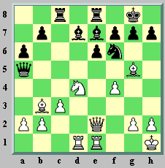
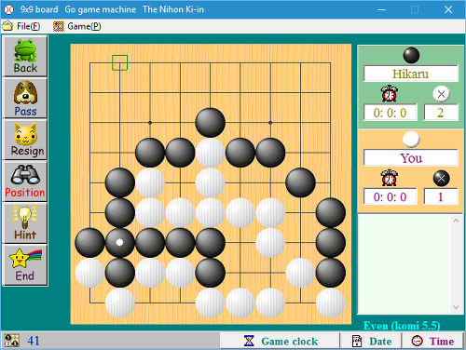
Traditional Games
Board games
Card games
etc.

Slide 26
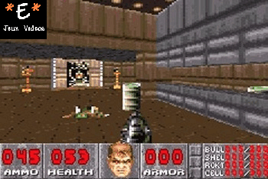
First-Person Shooters (FPSs)
3D version of arcade games
Fast action
Many examples: Doom, Quake, …

Slide 27
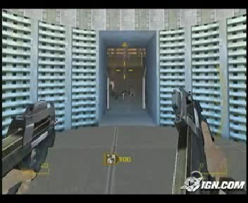
First person

Slide 28
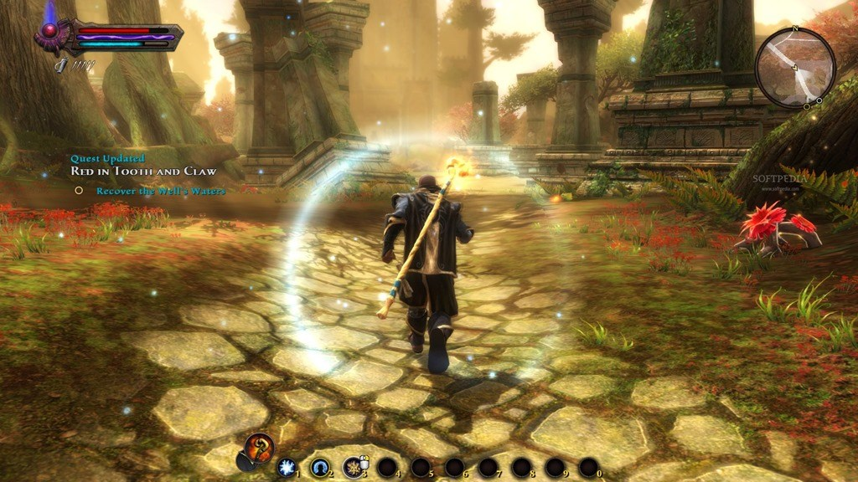
Role Playing Games (RPGs)
Move a character through a strange world
e.g. Final Fantasy, Ultima, Baldur's Gate
science fiction or fantasy setting
Become more powerful, find stuff

Slide 29
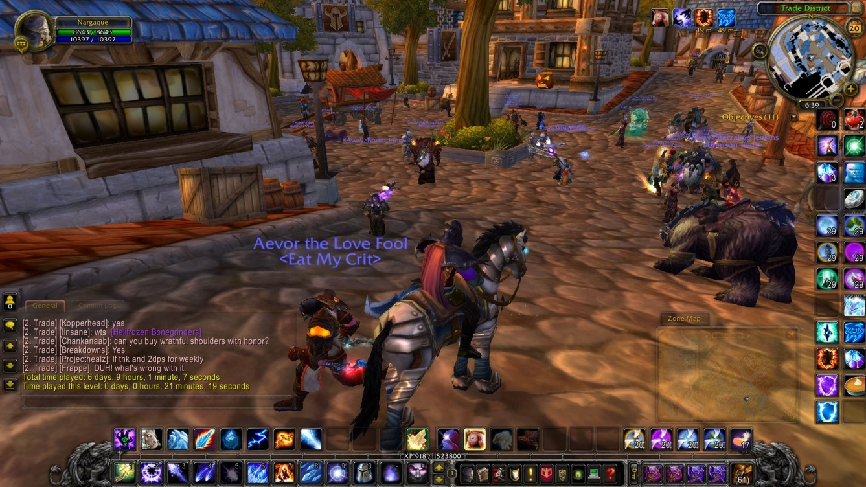
MMOGs (Massive Multiplayer Online Games)
Virtual worlds for thousands of players
e.g. Elder Scrolls Online, World of Warcraft

Slide 30
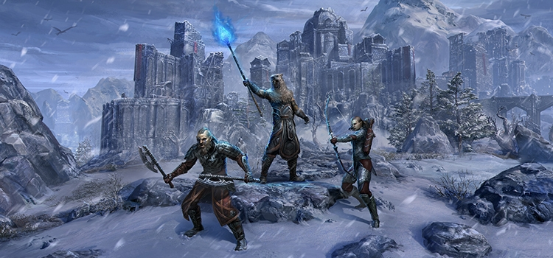

Slide 31
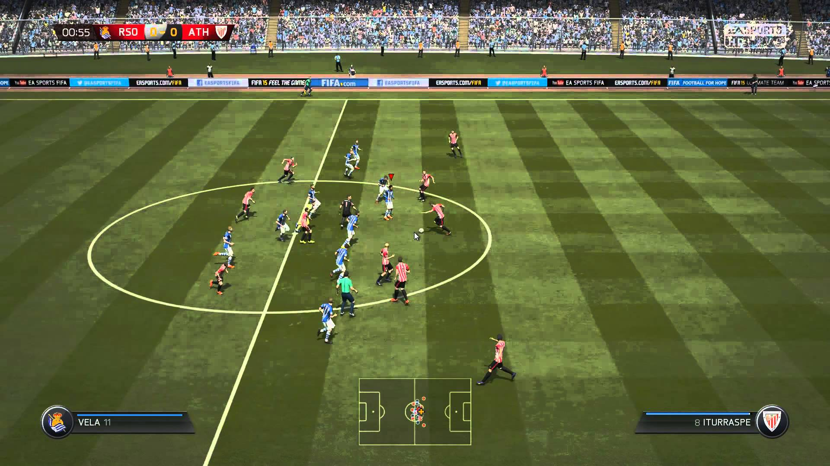
Sports Games
Real-life sport, made virtual
Examples
FIFA 16
NBA 2K16
Rugby 06
Tony Hawks

Slide 32
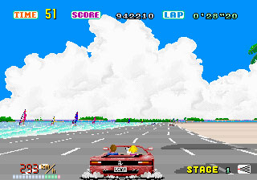
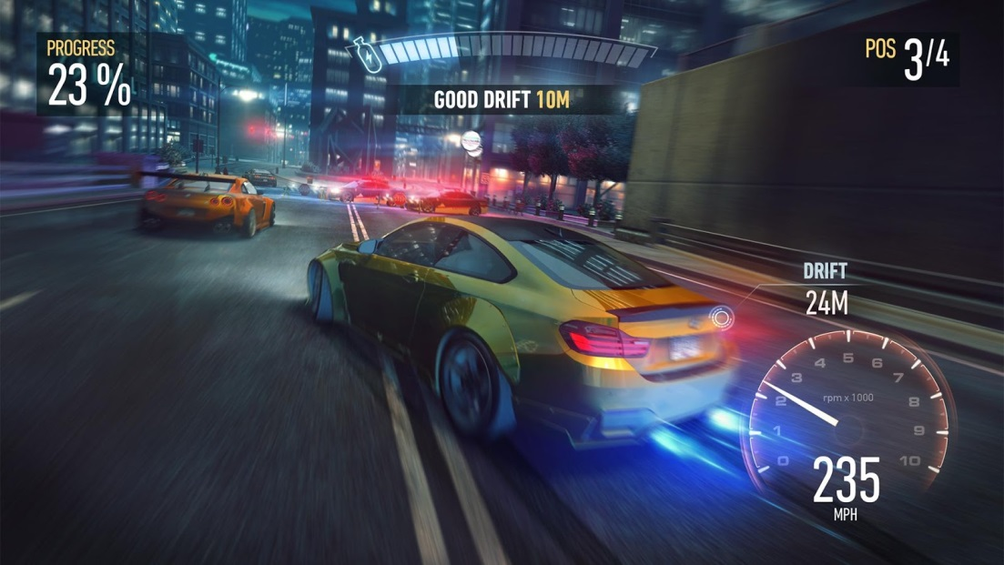
Racing Games
Special type of sports game
Drive a vehicle, as fast as possible
Need for Speed

Slide 33
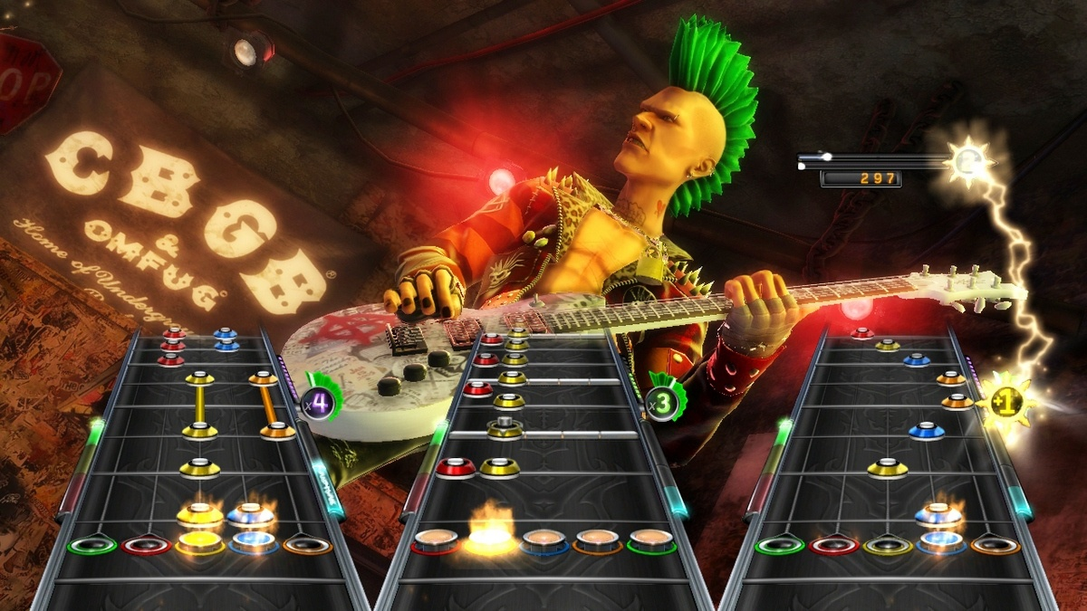
Party/Music Games
Many types
Ex: Mario Party, DDR, Karaoke, Guitar Hero
Play with friends

Slide 34
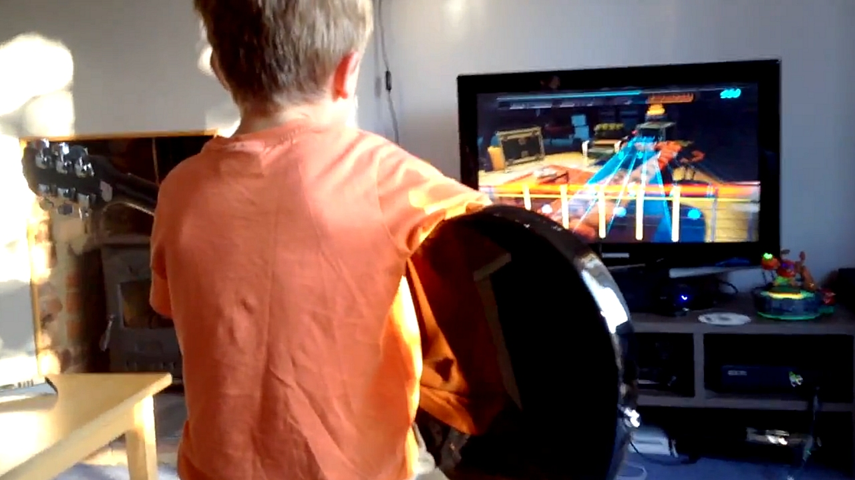
Unusual game input

Slide 35
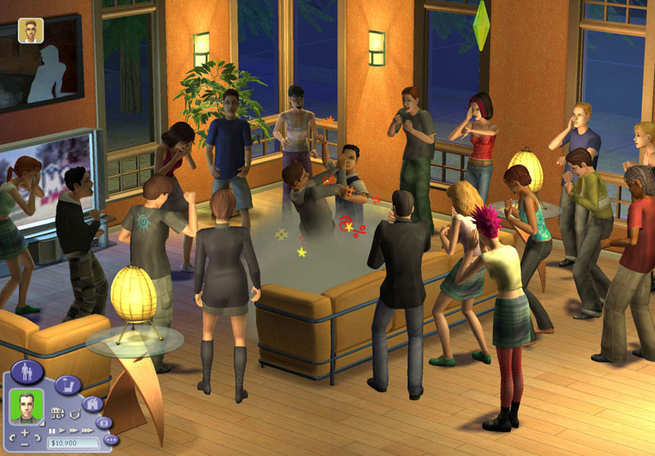
Simulators
Tries to look like real world
e.g. flight simulators, Train Simulator
World simulation
e.g. SimCity, SimEarth

Slide 36
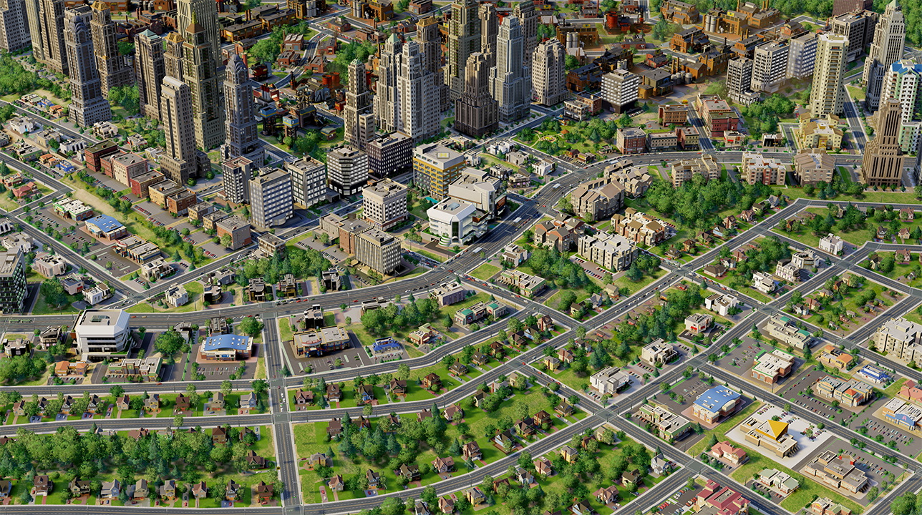
Isometric

Slide 37
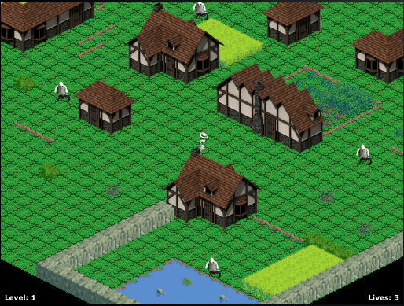
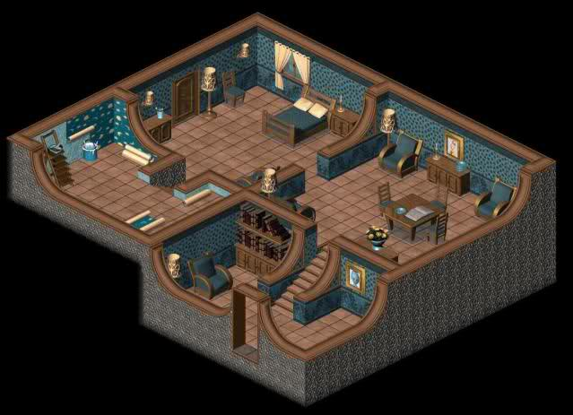

Slide 38
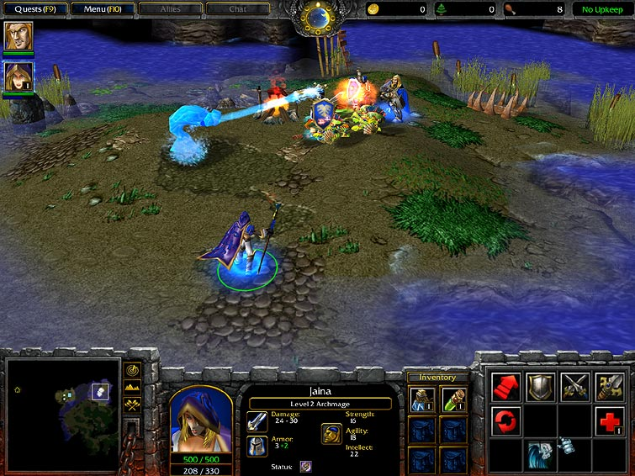
Real-Time Strategy (RTS)
Careful planning and resource management
Usually in a war
Example:
Age of Empires, Warcraft III…

Slide 39
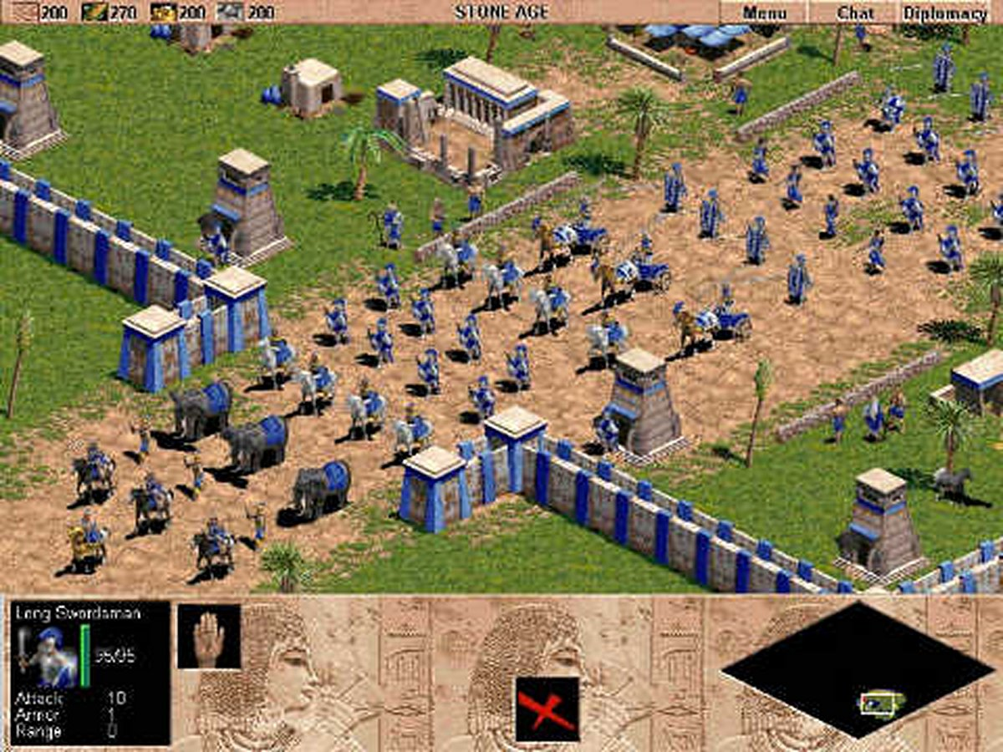
Age of Empires

Slide 40
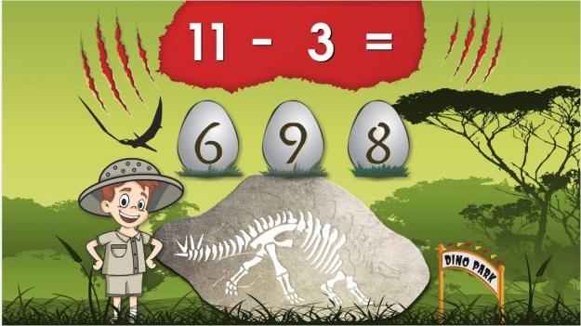
Educational Games
Teach stuff to kids
Ex: math, reading, problem solving

Slide 41
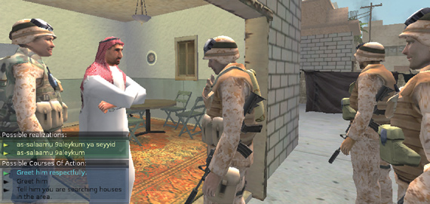
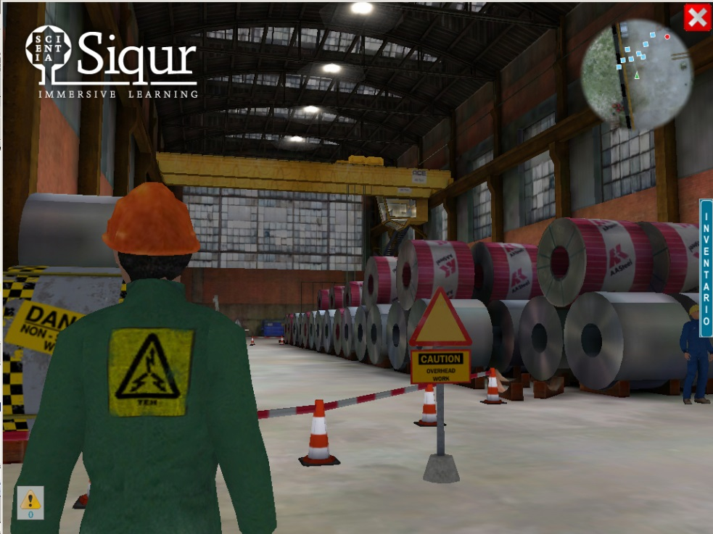
Serious Games
Teach stuff to adults

